Slide 1

Applied Physics
(Computer Science Department)
Sample problems
Coulomb’s Law
Lecture – 02
Engr. Asif Ali

Slide 2
Problem-01

Slide 3
Problem-02

Slide 4
Problem-03

Slide 5
Problem-04

Slide 6

Problem-05

Slide 7
Problem-06

Slide 8
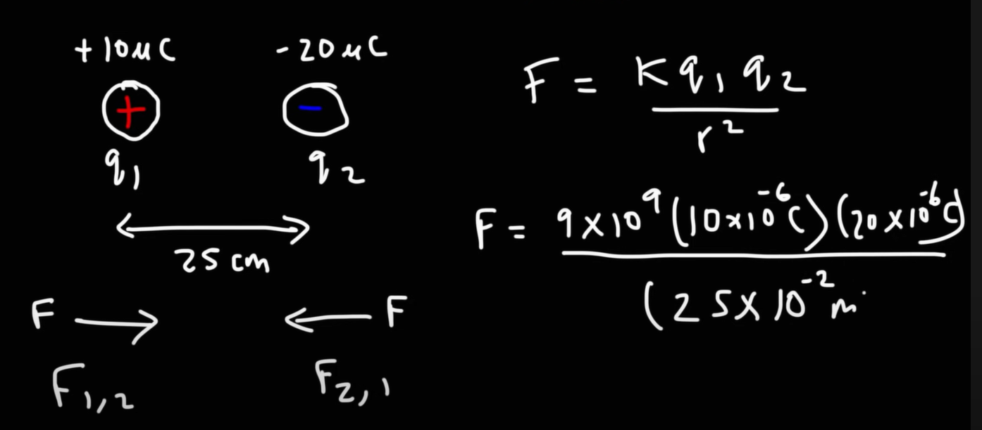
Problem-01
Solution

Slide 9
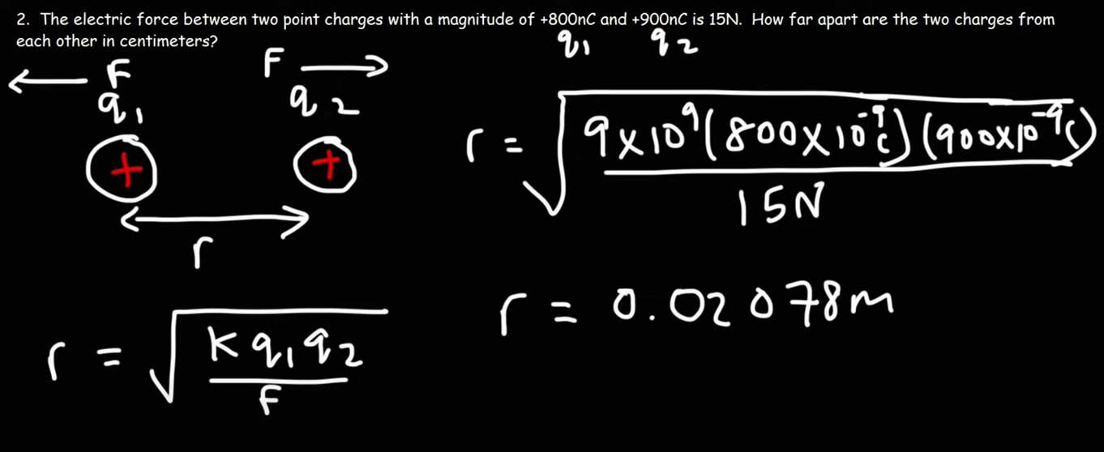
Problem-02
Solution

Slide 10
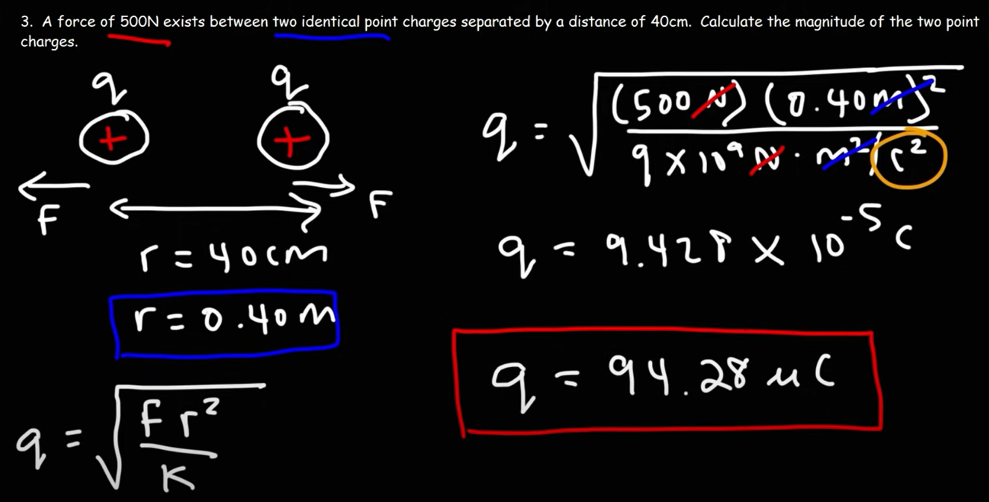
Problem-03
Solution

Slide 11
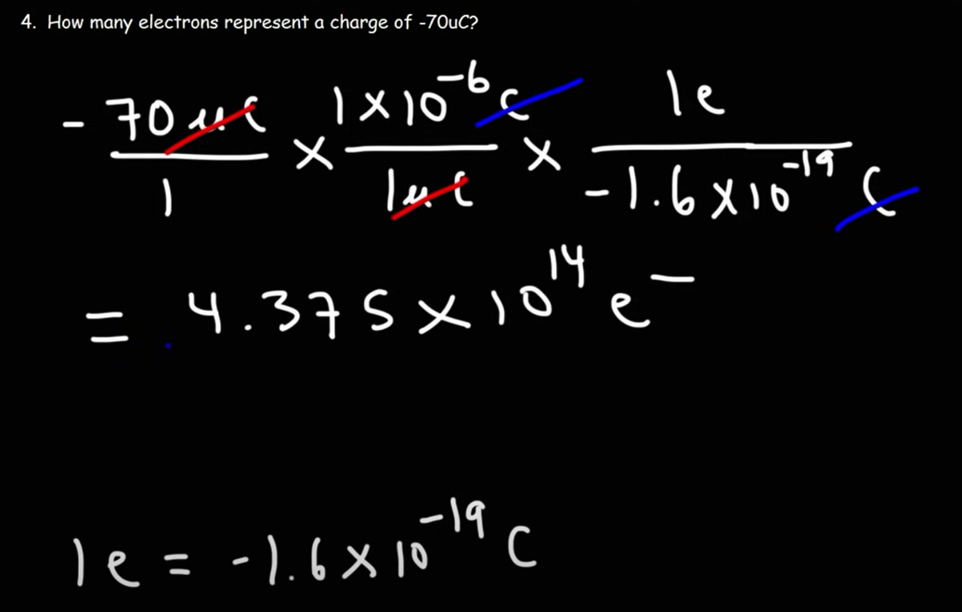
Problem-04
Solution

Slide 12
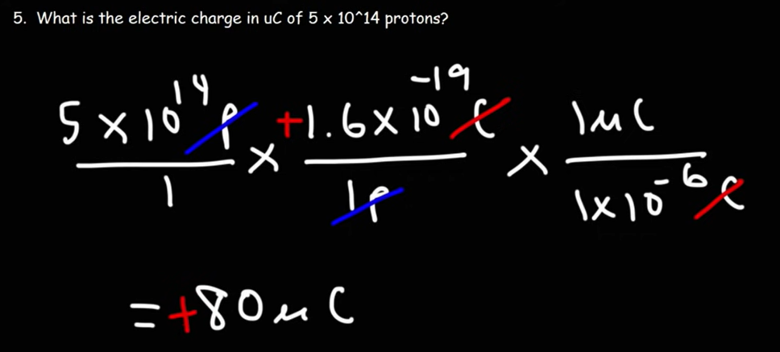
Problem-05
Solution

Slide 13
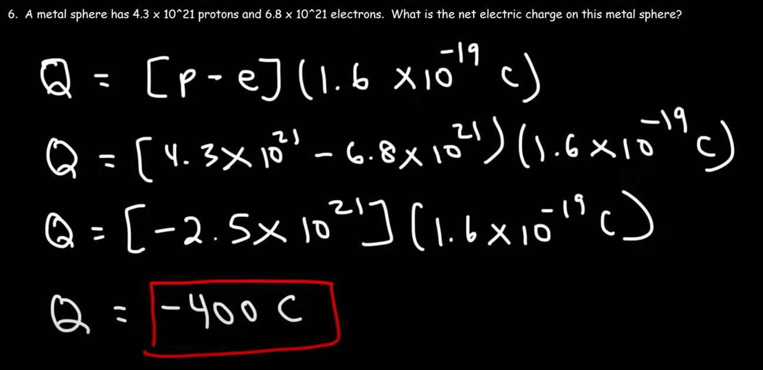
Problem-06
Solution

